Slide 1
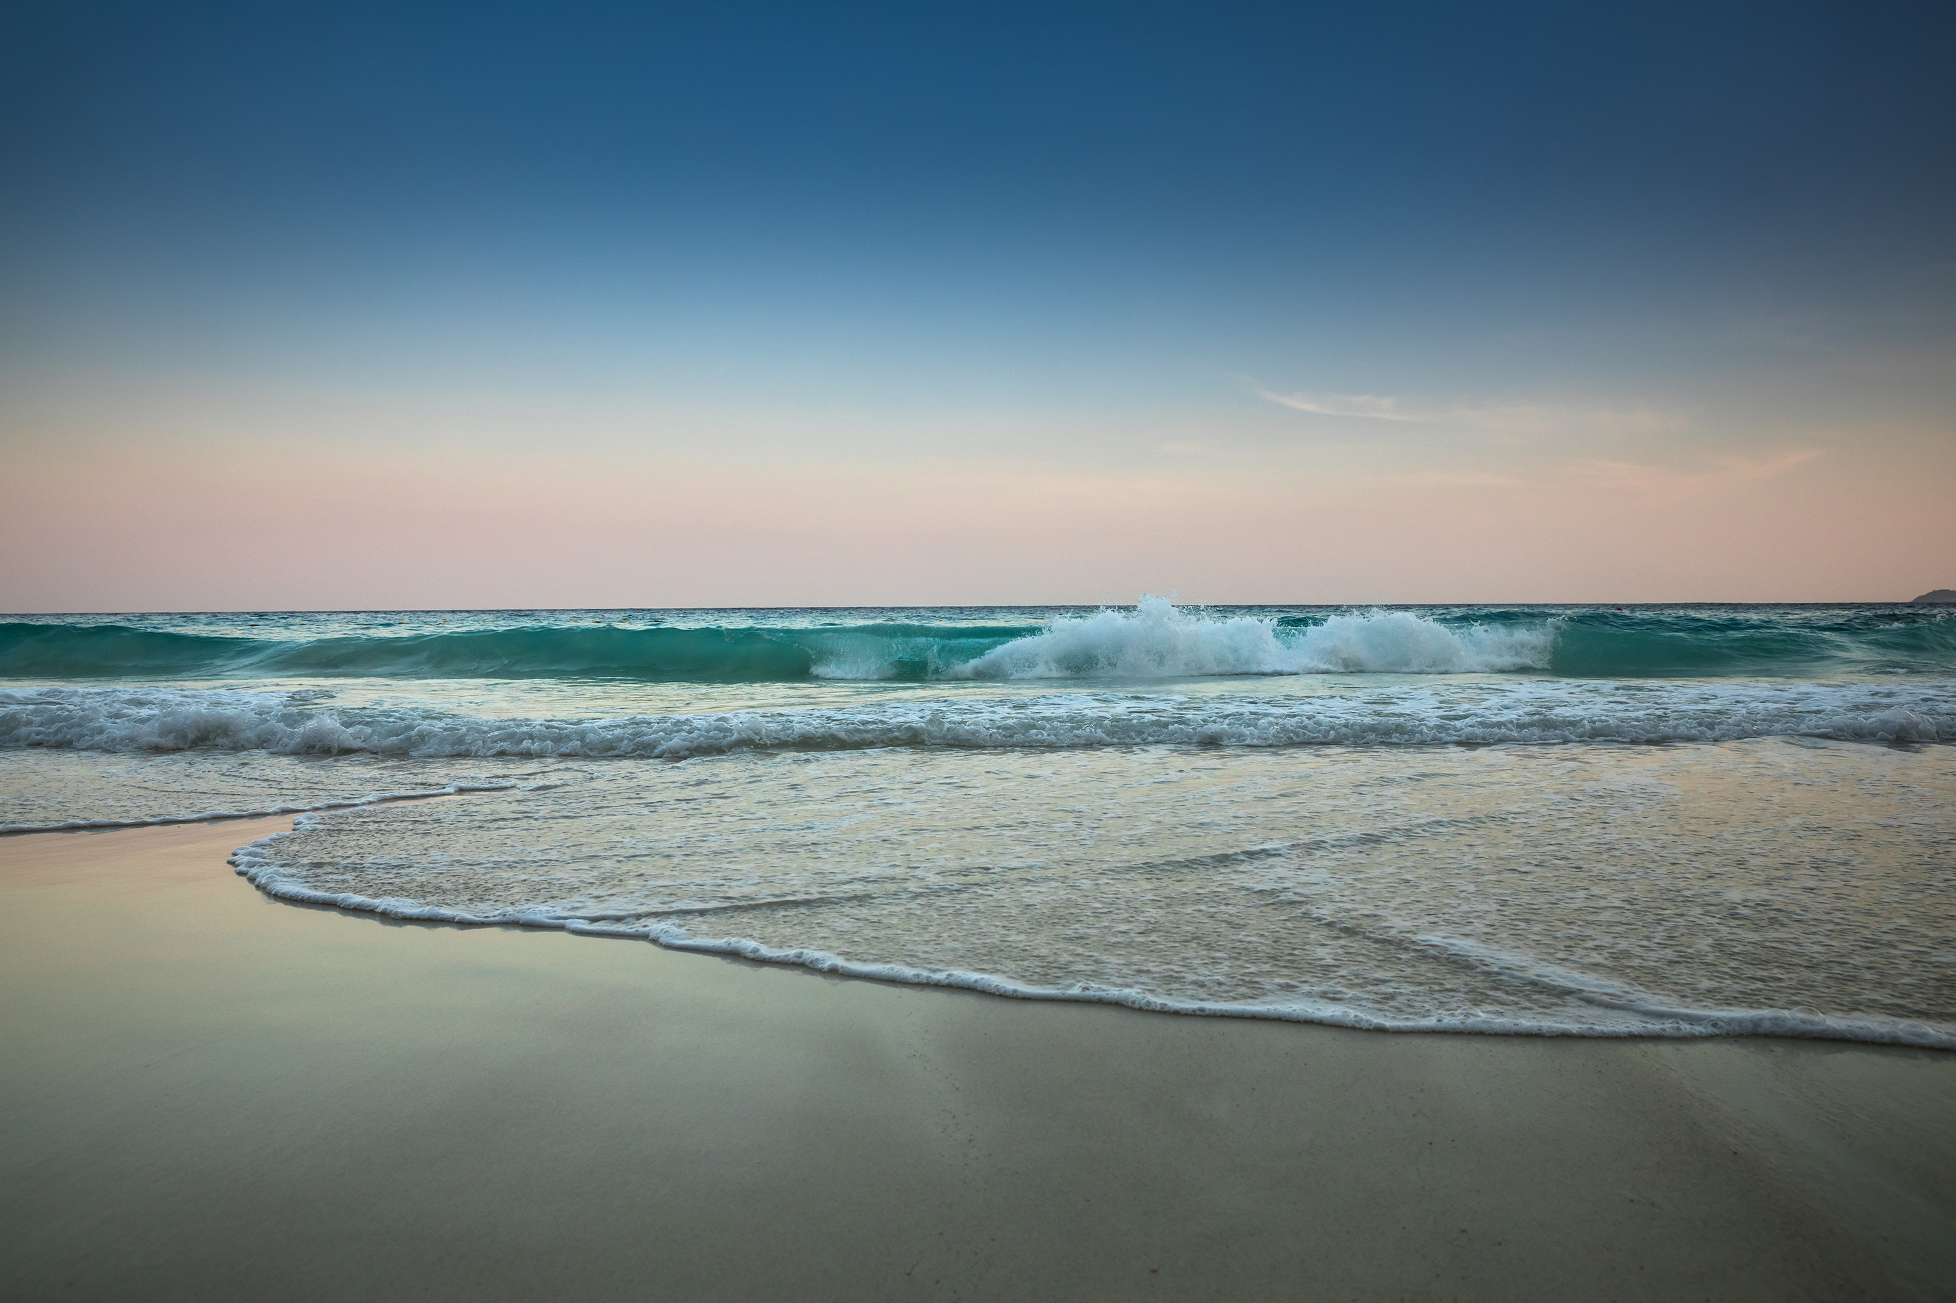
Wonders of Water
Girl Scout Brownie – WOW Journey
Notes:
Development Notes:
Created: 3/1/2026
Last Updated: 3/21/2026
Canva
Jennifer Swanson
Font – Tropika
Text to Speech Audio – Lisa
Video - Opening
Ocean waves
Have background music play throughout the video.

Slide 2
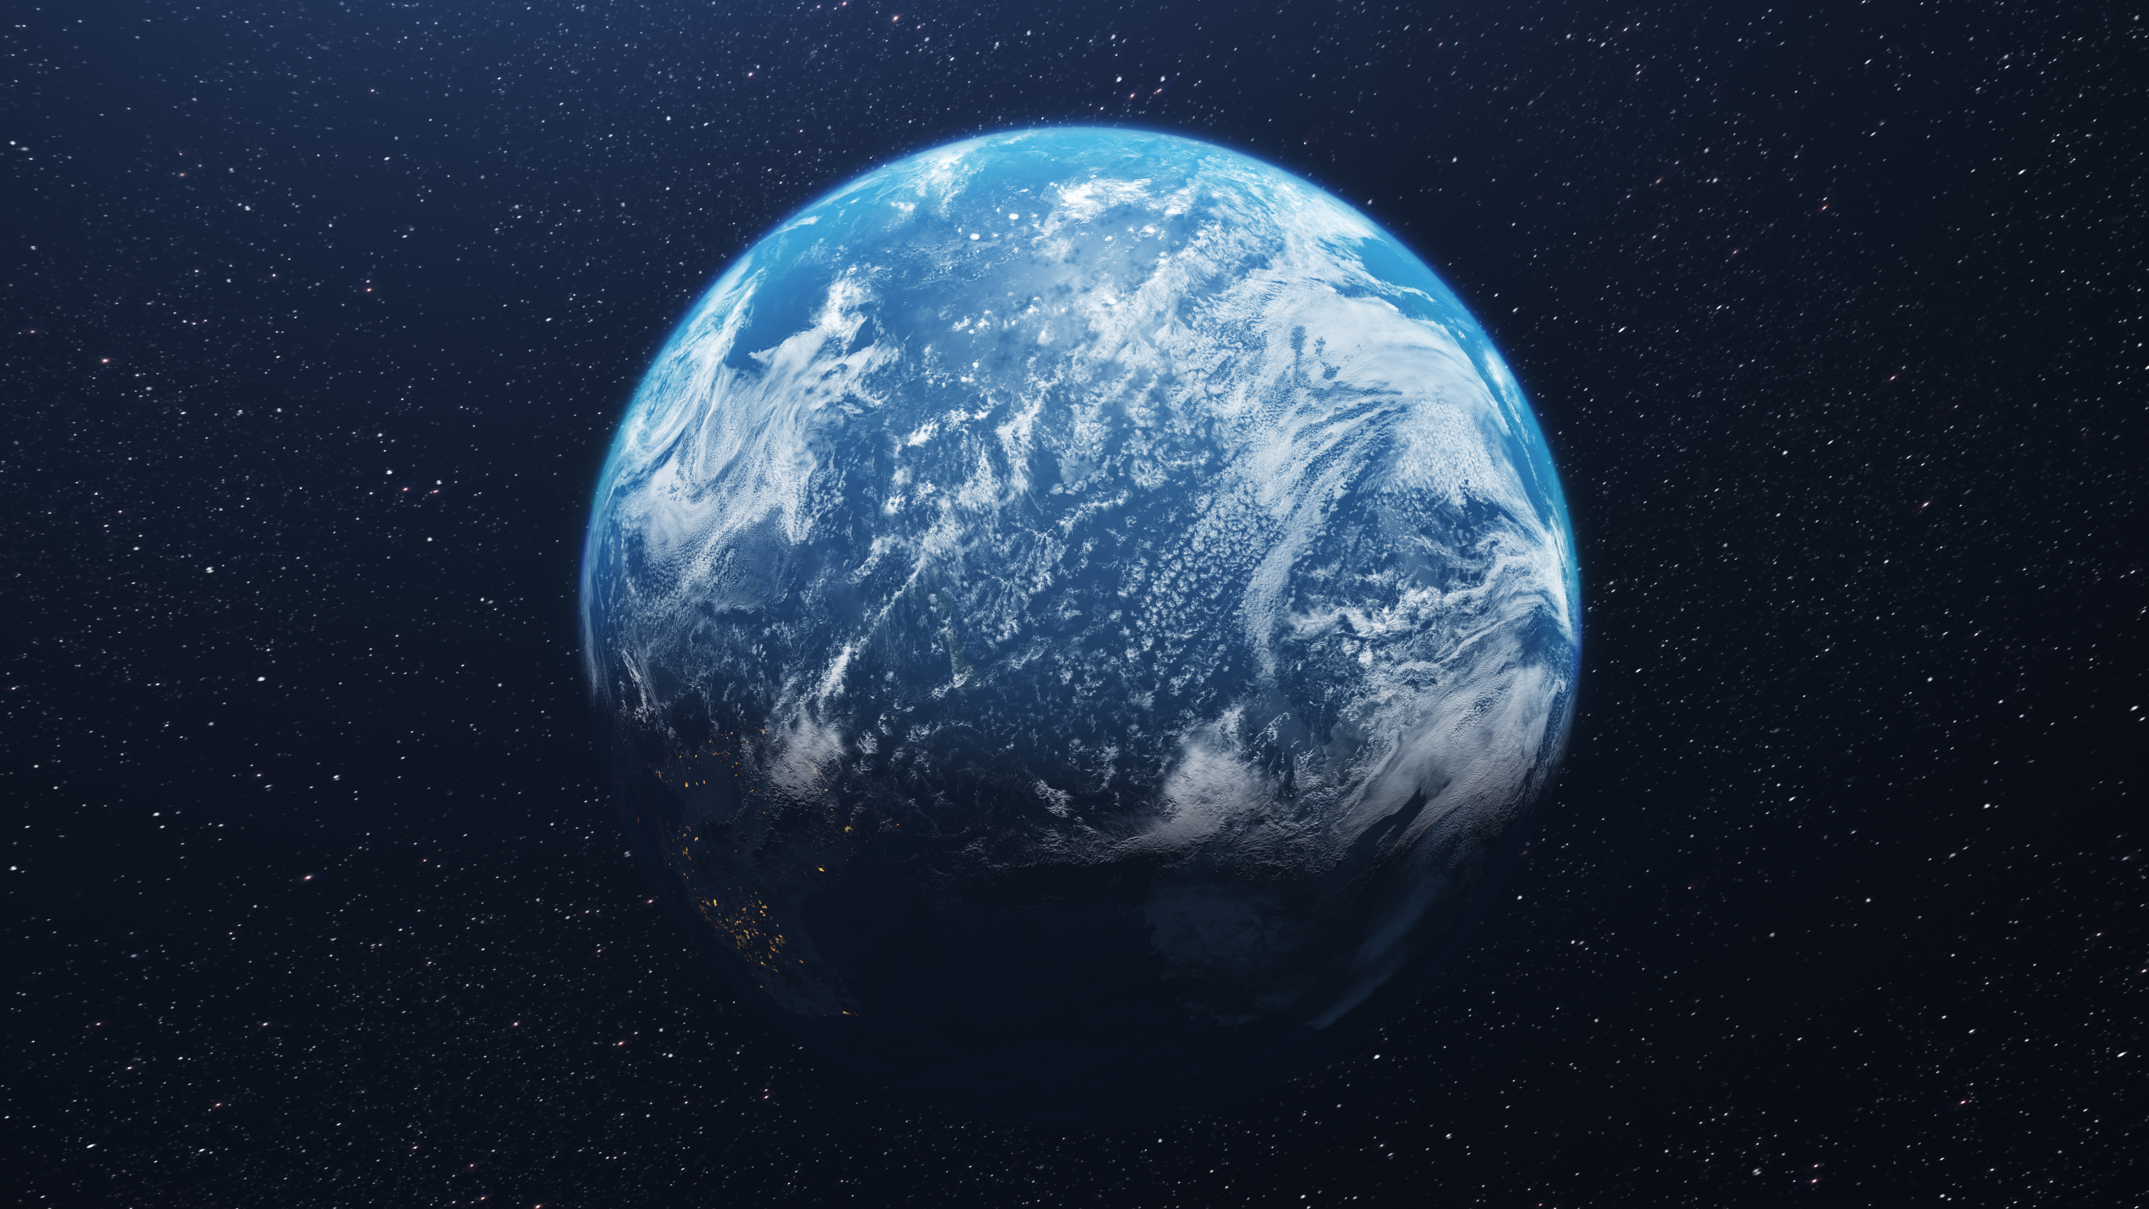
Notes:
Audio Script:
If you look at Earth from space, it looks like a blue marble.
It is known as the blue planet because it is 70% water.

Slide 3
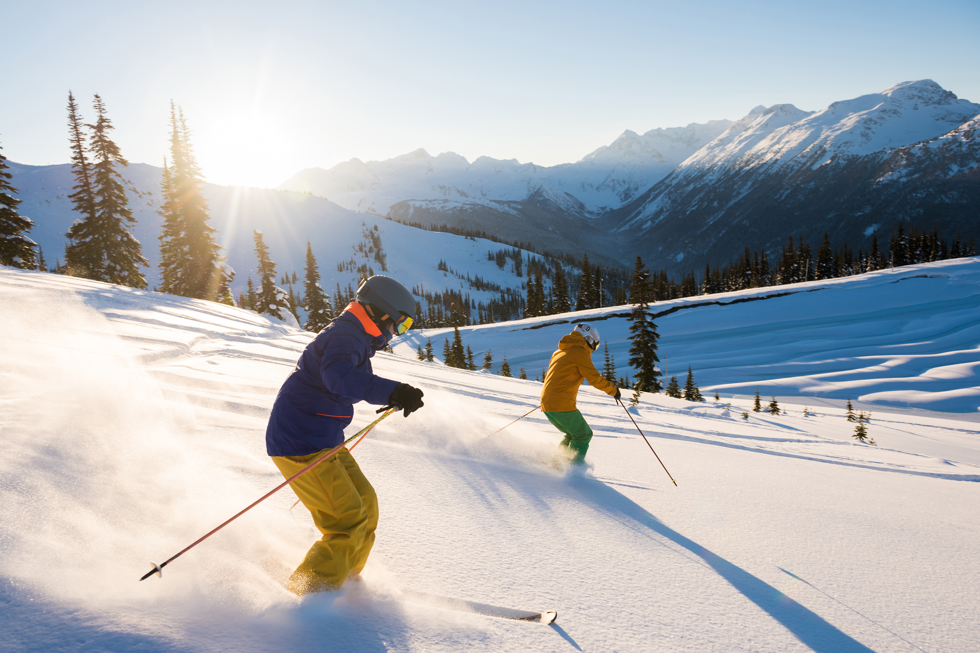
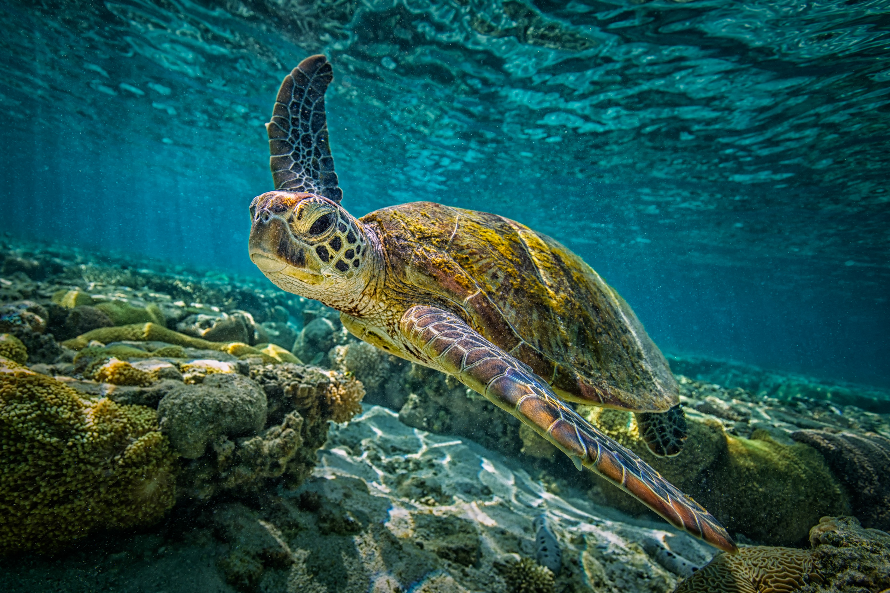
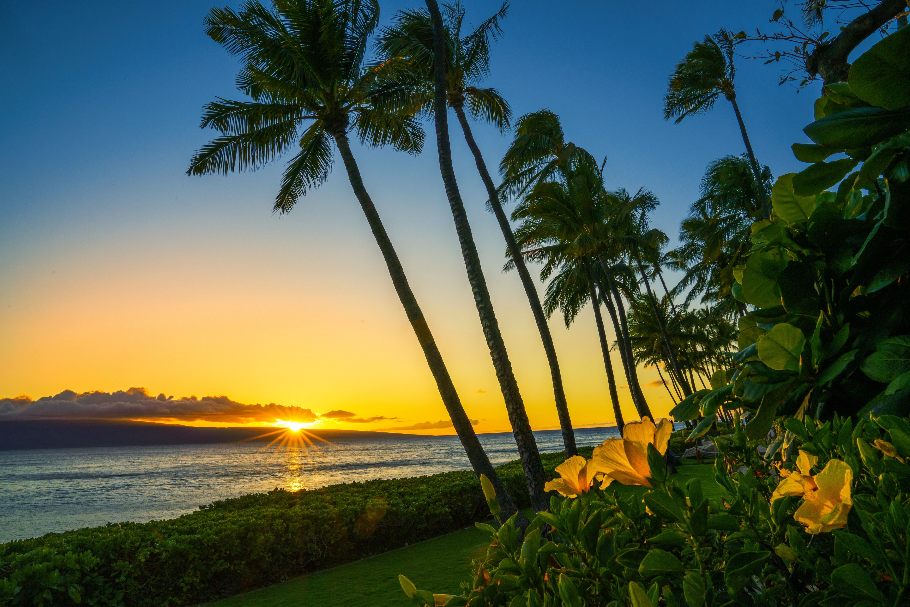
Notes:
Audio Script:
There are many ways we enjoy water in all its different forms.
Frozen water to go skiing, enjoying a nice refreshing glass of water,
Snorkeling and exploring the depts of oceans, or relaxing on a beach and
swimming in lakes, pools, rivers or oceans.

Slide 4
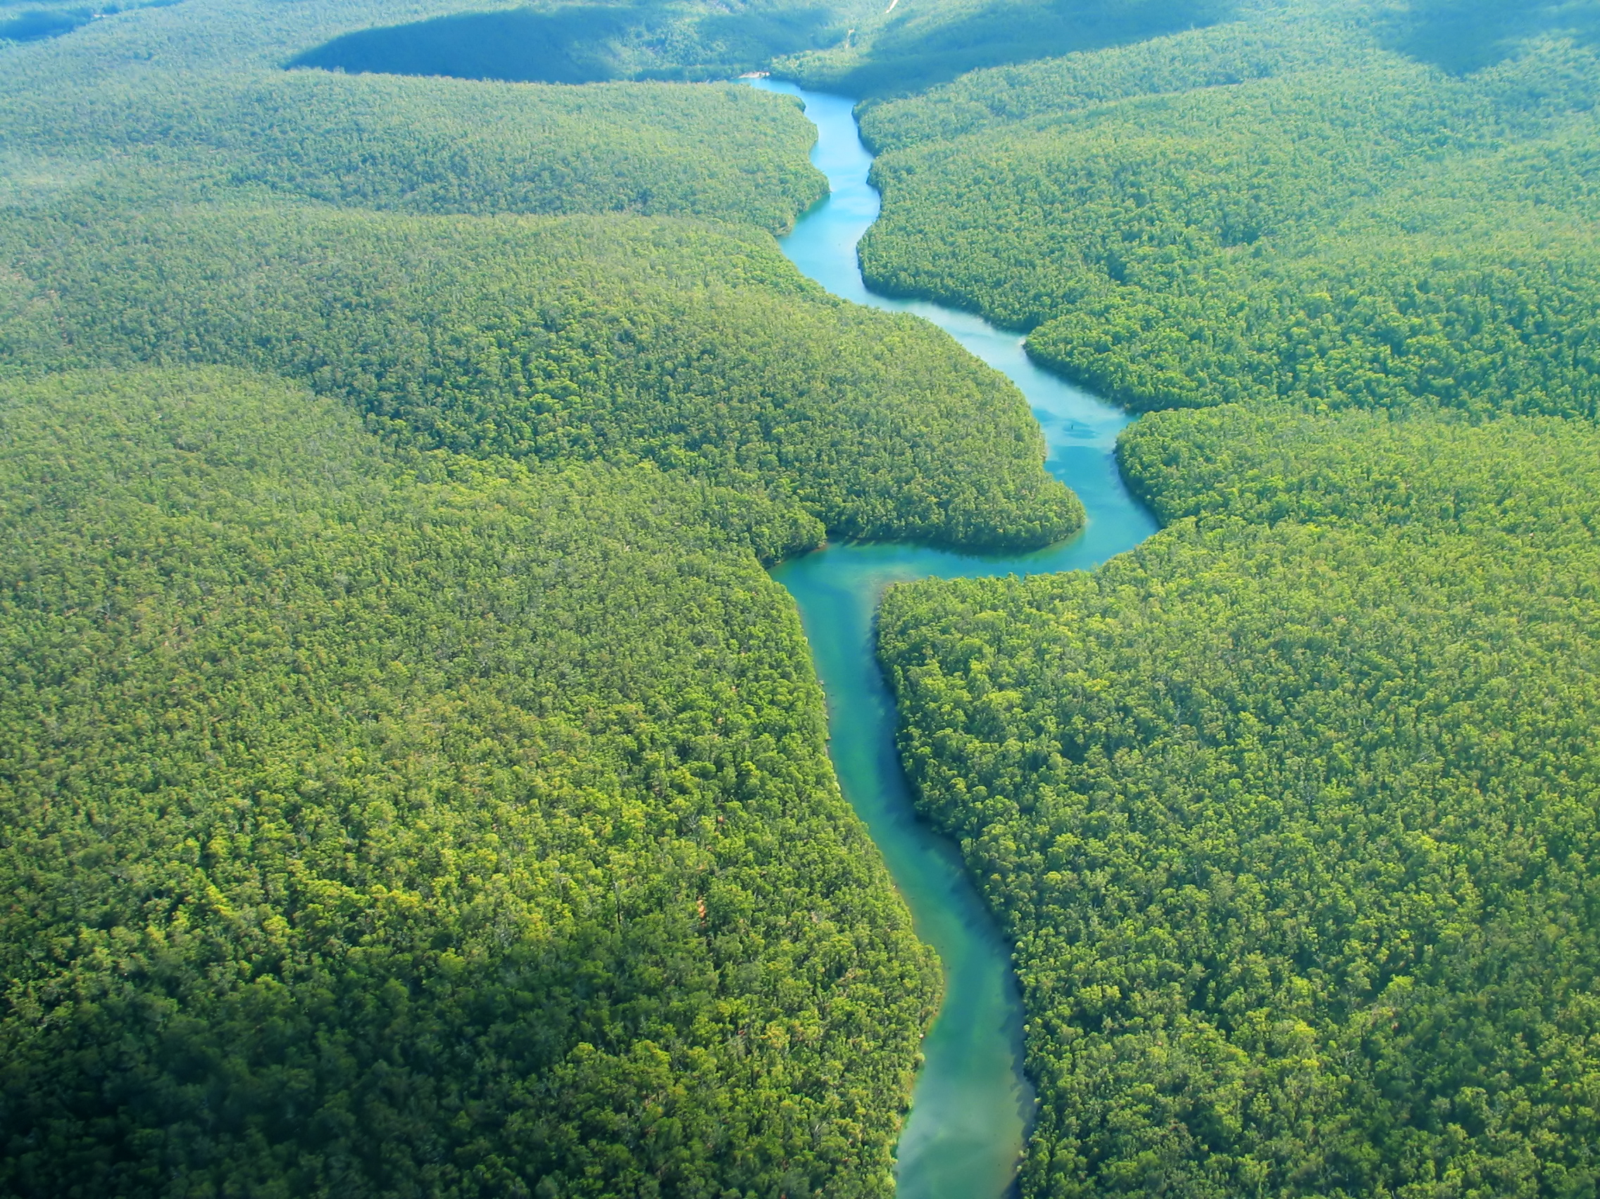
Notes:
Audio Script:
Water is what gives our planet life.
Without water, there would be no life.
Every living thing on Earth needs water survive.

Slide 5
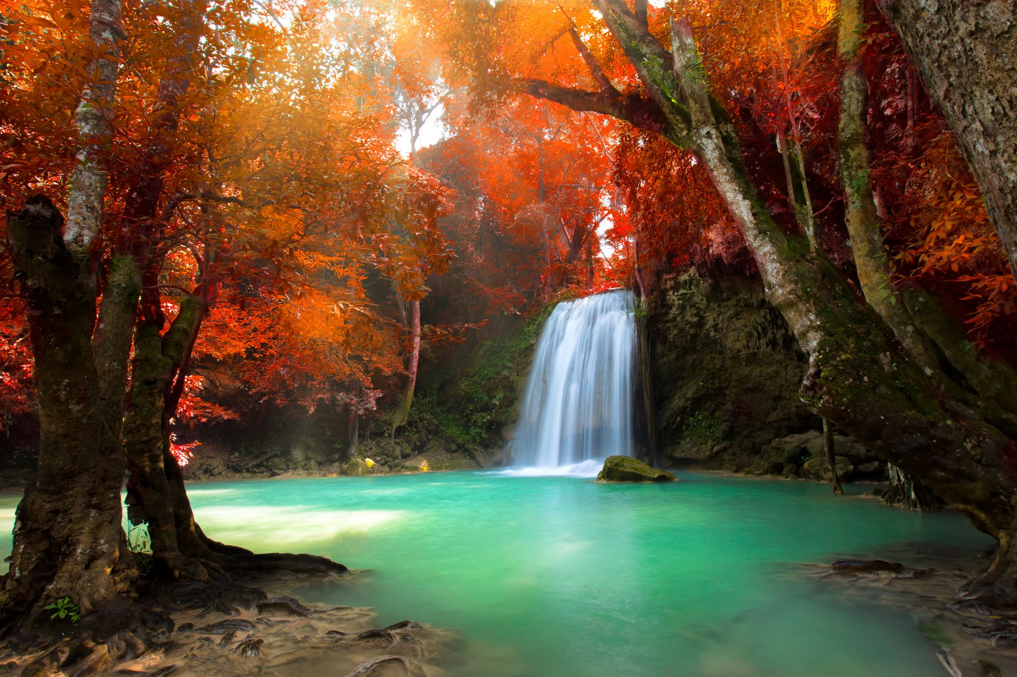
Notes:
Audio Script:
Even though Earth is 70% water,
Only 3% of the water is suitable to drink.
Which is why water is so precious and we should
Take care of the water on our planet.

Slide 6
The Water Cycle
Notes:
Audio Script:
There is continuous movement of water on, above, and below the surface of the Earth
Which is called the water cycle.

Slide 7



Evaporation
Notes:
Audio Script:
The water cycle starts with evaporation.
Heat from the sun causes water from oceans, lakes, and rivers to turn into
Water vapor (a gas) and rise into the air.

Slide 8

Condensation
Notes:
Audio Script:
As water vapor rises, it cools and turns back into tiny droplets forming clouds.
This is called condensation.

Slide 9

Precipitation
Notes:
Audio Script:
When the droplets and clouds get too heavy, they fall to Earth as rain, snow, sleet, or hail in the precipitation step.

Slide 10

Collection
Notes:
Audio Script:
The last step is Collection. Where the water collects in rivers, lakes, oceans or soaks into the ground and the cycle starts again.

Slide 11
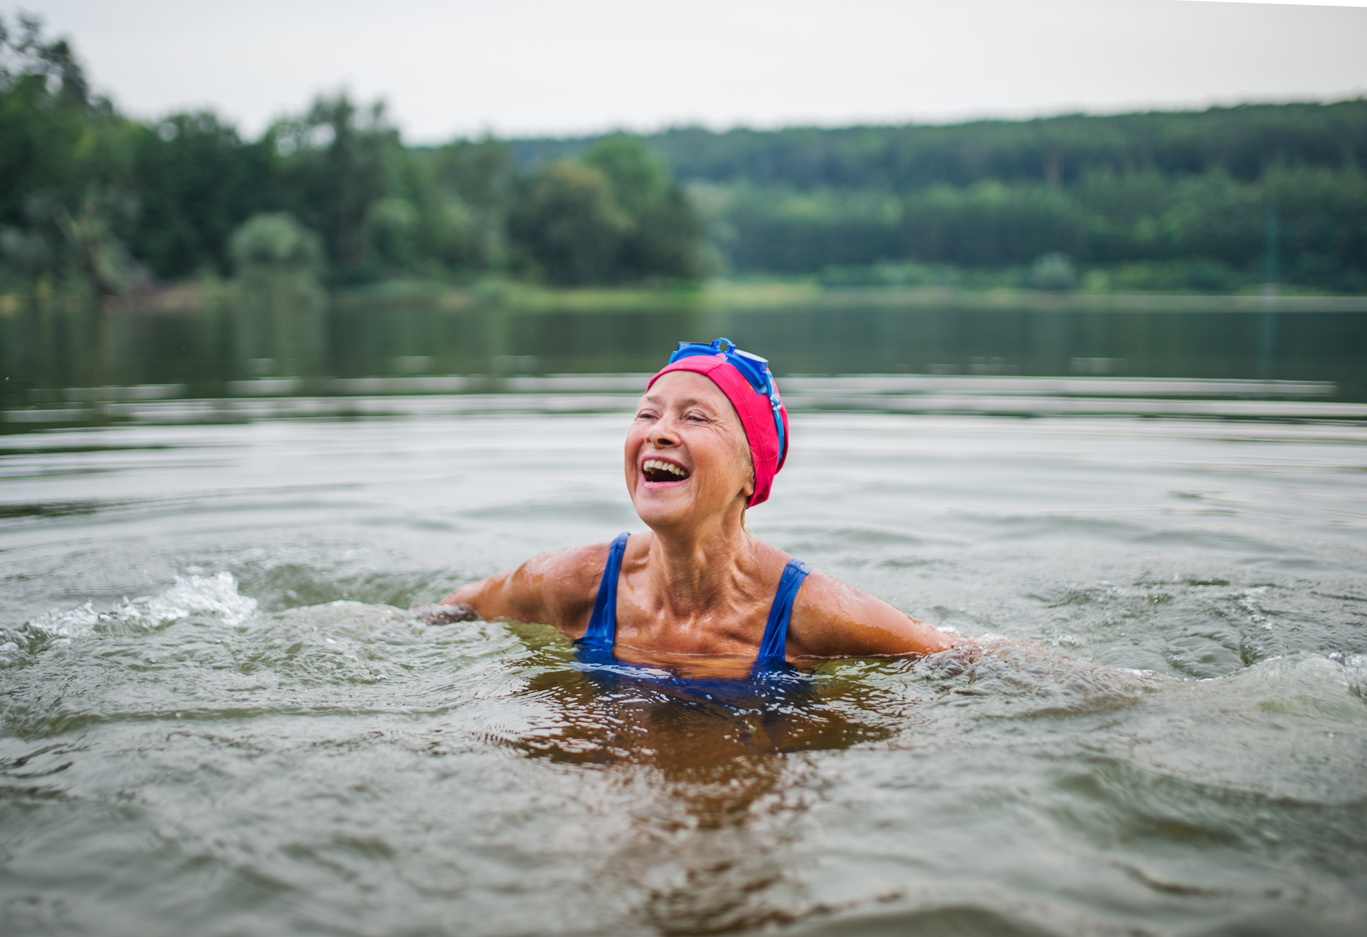
Notes:
End First Video
Show someone having fun with water. Music fades out.

